Slide 1
Week 5 – Final Project
Cody Angeline
The University of Arizona Global Campus
CST 499: Capstone for Computer Software Technology
Dr. Amr Elchouemi
January 23, 2023

Slide 2
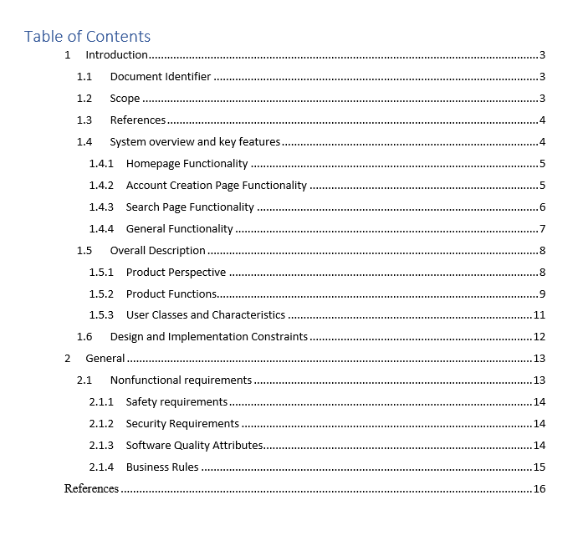
SRS Overview
During the elicitation of requirements, a software requirements specification (SRS) is generated. All artifacts generated during various meetings and design phases are captured here. The SRS serves decision makers and designers.

Slide 3
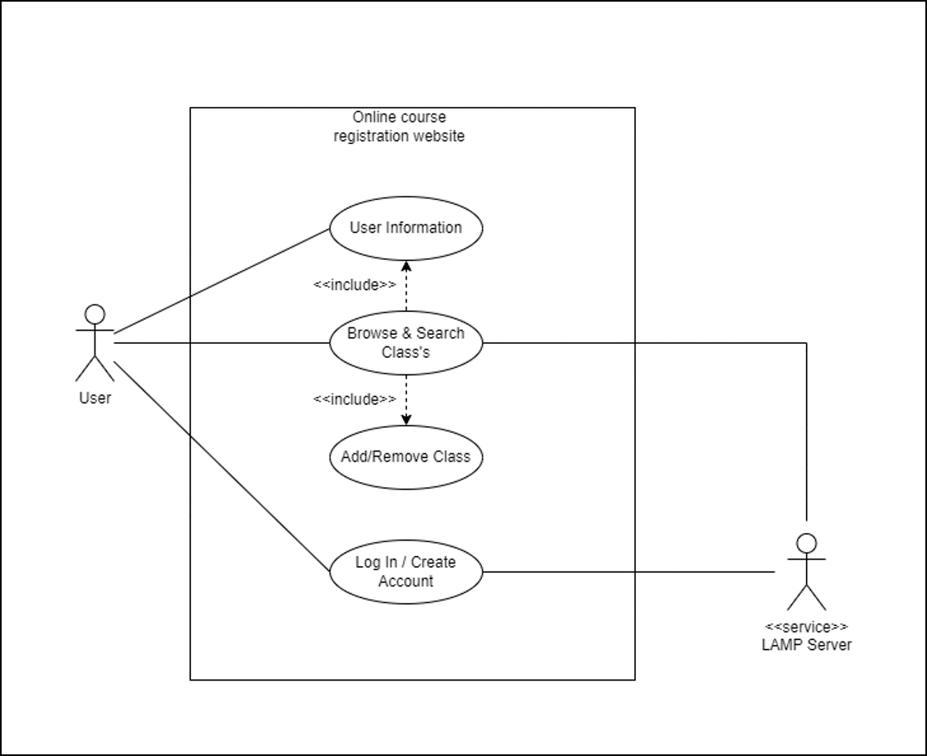
SRS Section 1.5.1: Product Perspective
A use case model is a form of interaction model, and is used to provide a simple overview of the interaction of an actor with a system (Sommerville, 2018).

Slide 4
SRS Section 1.5.2: Product Functions
Use cases describe the interaction between a user and a system through text diagrams. Use cases identify the actors involved in an exchange and the system’s desired state after the interaction. They portray actors who use the system and the process they must take to accomplish some goal (Tsui et al., 2018).
Use Case #1 | Account Creation
Goal in Context | Create a new user account.
Scope & Level | Basic functionality.
Preconditions | The user has prompted the system to make a new account and is on the account creation page.
Success End Condition | All information is filled in & user strikes the “Submit: button.
Trigger | The user strikes the “Create Account” button.
Description | The user utilizes the submit button once all information has been entered.
Use Case #2 | Account Login
Goal in Context | A textbox serves to receive user credentials for login.
Scope & Level | Basic functionality.
Preconditions | The user has entered a username and password.
Success End Condition | The user account exists, all information is entered & user strikes the “Login” button.
Trigger | The user selects the “Login” button.
Description | The user enters their login credentials, is validated, and is logged into their account.
Use Case #3 | Course Search
Goal in Context | A drop-down menu that shows all of the available courses.
Scope & Level | Basic functionality.
Preconditions | The user has initiated the “Course Search” dropdown menu.
Success End Condition | The user selects a single course & user strikes the “Submit” button.
Trigger | The user has initiated the “Course Search” dropdown menu.
Description | The user activates a dropdown menu that displays the university’s available courses.

Slide 5
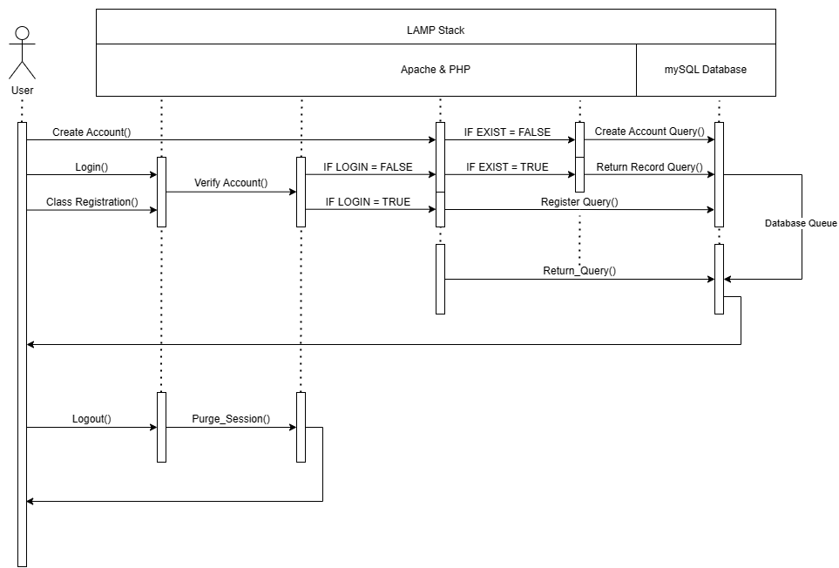
SRS Section 1.5.3: User Classes and Characteristics
Sequence diagrams are a form of interaction model, and are primarily used to portray the interactions of actors and system objects, as well as interactions between the objects themselves. These diagrams show, from left to right, an actor’s initiating action, followed by a potential number of class interactions within the system (Sommerville, 2018).

Slide 6
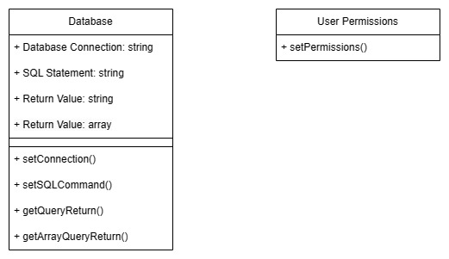
SRS Section 1.5.3: User Classes and Characteristics
Class Diagrams are known as structural models, and used to portray the object-oriented classes that exist within a system and their interactions with one another. Associations between classes are shown as link lines between either parameters or methods.

Slide 7
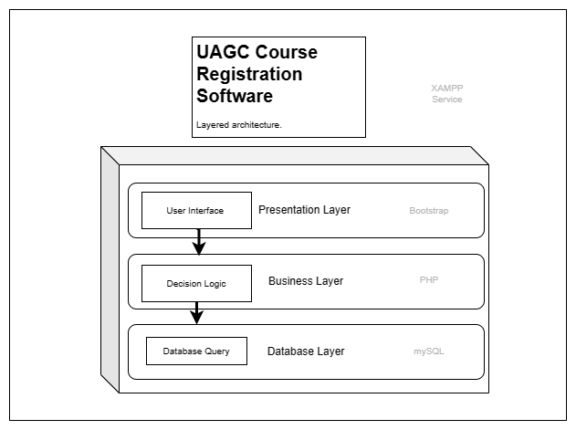
SRS Section 1.6: Design and Implementation Constraints
The architecture of the system will be the layered architectural approach, and be deployed on a Microsoft Windows 10 machine utilizing the Cross-platform, Apache, MySQL, PHP, and Perl (XAMPP) server hosting software.

Slide 8
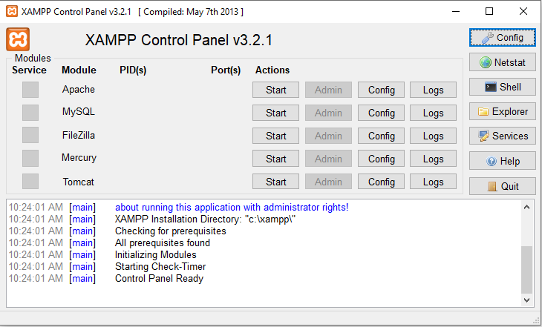
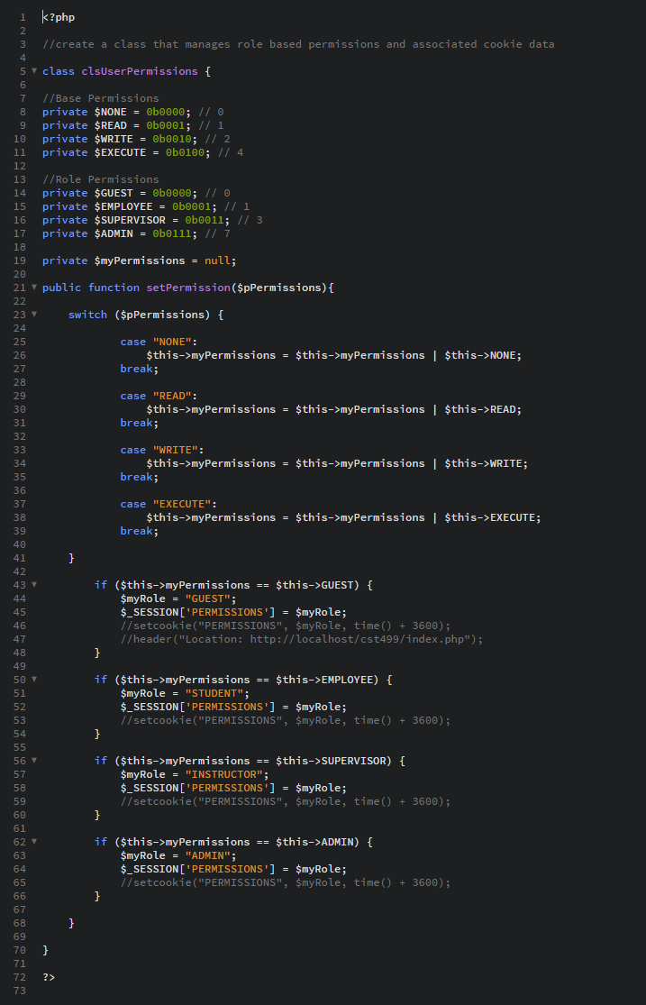
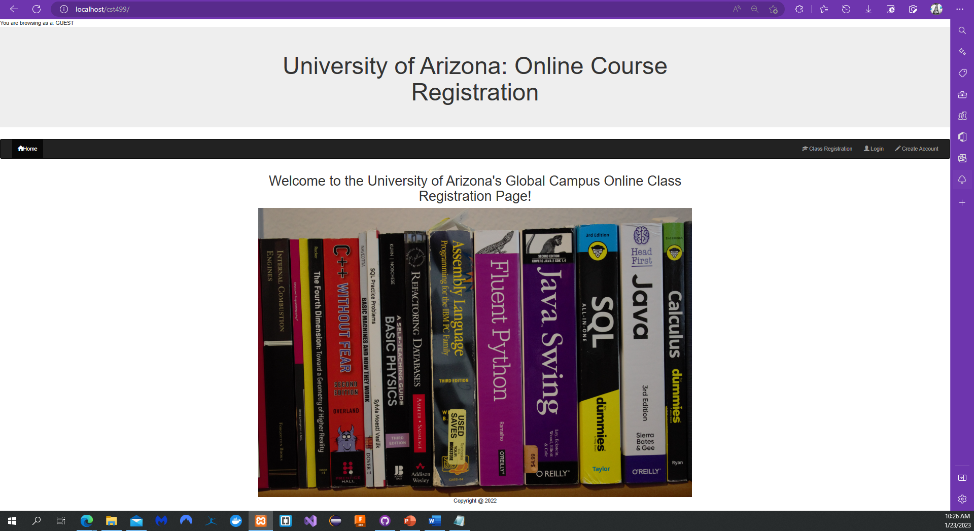
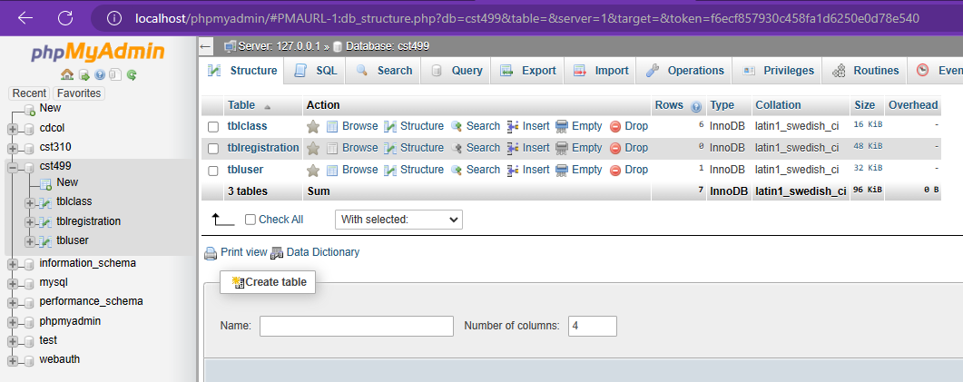
WAMPP Stack
SRS Section 1.6: Design and Implementation Constraints
The architecture of the system will be the layered architectural approach, and be deployed on a Microsoft Windows 10 machine utilizing the Cross-platform, Apache, MySQL, PHP, and Perl (XAMPP) server hosting software.
Business Layer
Presentation Layer
Database Layer

Slide 9
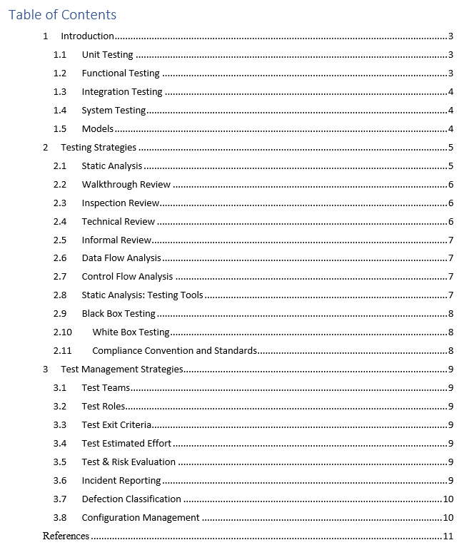
Test Plan Overview
Test plans grant designers and decision makers control over the quality of their product.

Slide 10
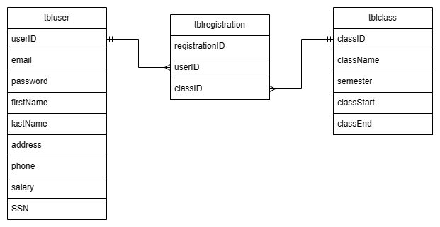
Database Design
A relational database design models the relationships of each table. This table is presented in crows foot notation, were double vertical lines next to a field indicate a primary key, and forked lines indicate a foreign key relationship.

Slide 11
References
Beck, K. (2003). Test-driven development. Pearson Education. ISBN 0-321-14653-0
Richards, M., Ford, N. (2020). Fundamentals of software architecture. O’Reilly Media Inc. http://oreilly.com/catalog/errata.csp?isbn=9781492043454
Sommerville, I. (2018). Software engineering (10th Edition). Pearson.
Spillner, A., Linz, T., & Schaefer, H. (2014). Software testing foundations: A study guide for the certified tester exam (4th ed.). Rocky Nook.
Tsui, F., Karam, O., & Bernal, B. (2018). Essentials of software engineering (4th ed.). Jones & Bartlett Learning.

